Slide 1
EECS 498 System Design of a Search Engine
Winter 2026
Lecture 20: The Citicorp Crisis and Backdoor to the iPhone
Nicole Hamilton
https://web.eecs.umich.edu/~nham/
nham@umich.edu

Slide 2
agenda
details
the Citicorp crisis
ethical spheres
backdoor to the iPhone

Slide 3
agenda
details
the Citicorp crisis
ethical spheres
backdoor to the iPhone

Slide 4
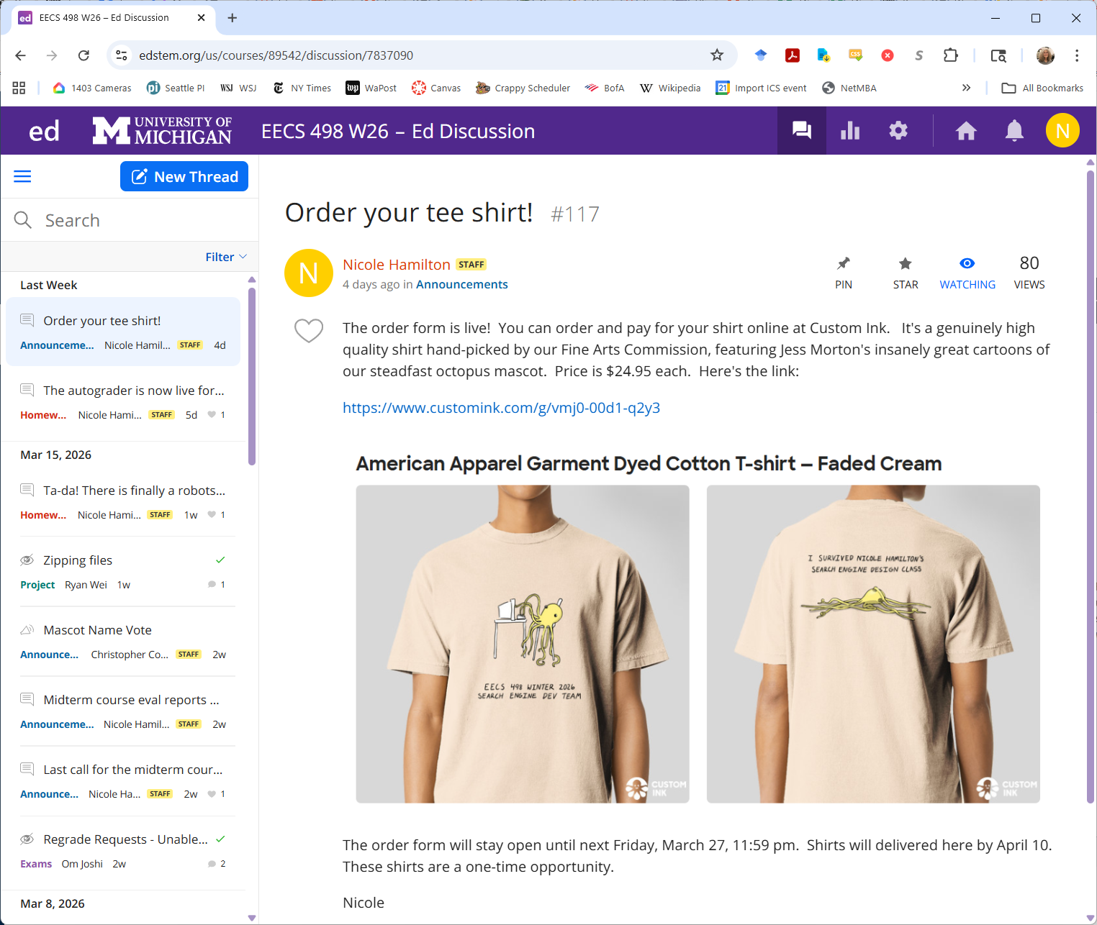
tee shirt orders close tomorrow

Slide 5
details
Please read my ranking paper.
The best heuristics are the ones that can cherry pick the really good matches out of the sea of trash.
Lab on getting starting on GCP will be next week. You’ll go from logging in the first time to building and running your LinuxGetSsl utility.

Slide 6
details
We are now into fun topics while you build your engines. Today will be some case studies on ethics.
I’m thinking negotiations next, followed by organizational behavior.
I’m also thinking of a lecture on time value of money and cash flow diagrams? To enjoy it, you will need a free HP-12 financial calculator emulator on your phone or laptop.

Slide 7
example problem
You need a car for the next 3 years and you’re considering two alternatives.
1. An older gas guzzler for $5,000 which you estimate will require $150/month for gas and $100/month on repairs. After 3 years, you expect it could be sold for $3,000.
2. A newer, more efficient car that for $12,000 that would need only $80/month in gas and $40/ month for repairs. After 3 years, you expect it could be sold for $6,000.
You’re living on money you’re borrowing at 8% APR. Which is the better deal?

Slide 8
NPV = -$10,616.19
Month
$3,000
1 2 3 4 5 6 7 8 9 10 35 36
Gas
guzzler
…
$5,000
Initial cost
$250 per month for gas + repairs
$6,000
NPV = -$11,105.89
Month
1 2 3 4 5 6 7 8 9 10 35 36
…
Efficient
car
$12,0000
Initial cost
$120 per month for gas + repairs

Slide 9
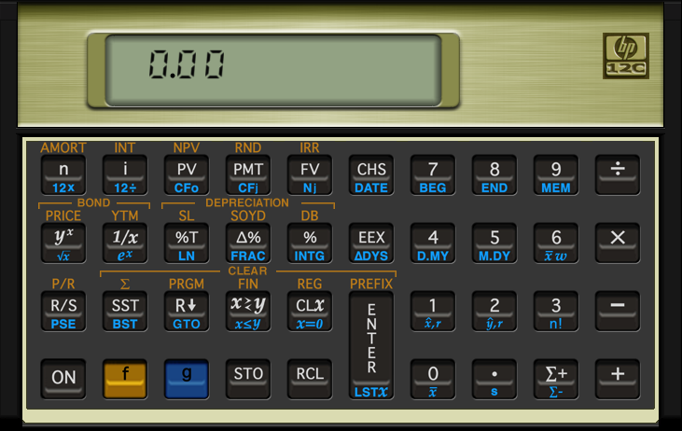
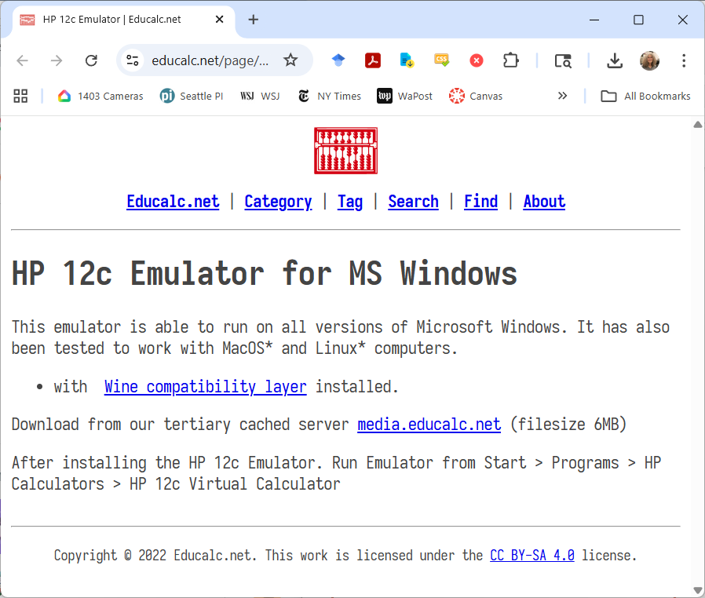
you’ll need an HP-12 emulator
Fortunately, HP released a free one. https://www.educalc.net/page/2338917/

Slide 10
agenda
details
the Citicorp crisis
ethical spheres
backdoor to the iPhone

Slide 11
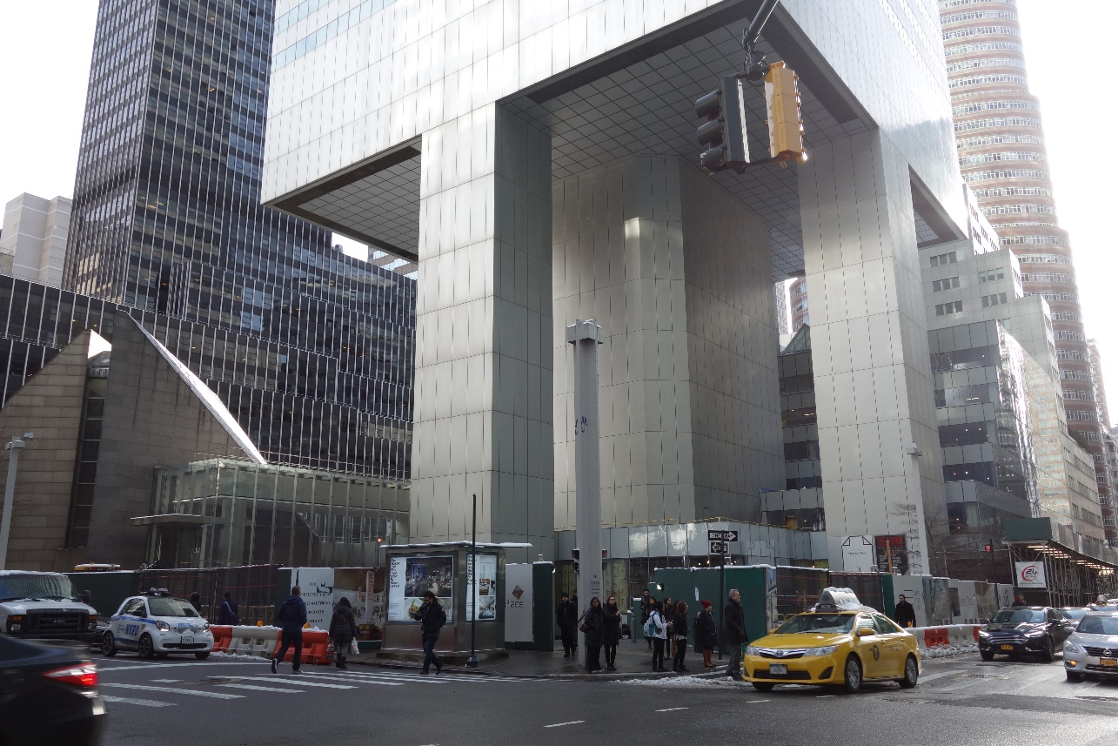
the Citicorp Center crisis
The lot was owned by St. Peter’s. They initially refused to sell but finally agreed on condition the bank would build a new church next to the tower on the same lot.

Slide 12
the Citicorp Center crisis
To maximize floor space, William LeMessurier, the structural engineer, came up with the idea of building it on 9-story high stilts, with the church under one of the corner.
So the columns wouldn’t go through the church, he moved them to the middle of each side.

Slide 13
the Citicorp Center crisis
Diane Hartley, an UG working on her thesis in civil engineering at Princeton studied the plans and noticed it appeared more likely to topple in a hurricane than traditional designs.
She contacted LeMessurier’s offce and was initially brushed off.

Slide 14
the Citicorp Center crisis
LeMessurier heard about the call and decided to check his calculations.
To his horror, he discovered that the strongest wind loads would not be perpendicular as he’d assumed.
If high winds hit at a 45° angle, the building was in danger of collapse.

Slide 15
the Citicorp Center crisis
LeMessurier also found that the load-bearing columns had been bolted together instead of welded as specified in his drawings, making the considerably weaker.

Slide 16
the Citicorp Center crisis
LeMessurier calculated that the tower could fall in a 16-year storm if power to the powered mass damper on the roof failed.
And even with power, the tower would fall in a 55-year storm.
The risk it would fall in any given year was roughly equal to the probability of drawing the King of Spades.

Slide 17
the Citicorp Center crisis
LeMessurier became aware of this at the beginning of the 1978 hurricane season.

Slide 18
the Citicorp Center crisis
New York building code only required designers to consider perpendicular winds, so, in a strict legal sense, he had not violated the building code.
But he felt a moral obligation to the people in the building and realized his career could be over if this became known.

Slide 19
the Citicorp Center crisis
Who should be informed?
Did the public have a right to know?
Was LeMessurier the only person morally obliged or did he share responsibility?
What should he do?
You have 5 minutes to discuss.

Slide 20
what he actually did
Decide to contact Citicorp to explain the problem but worked out a plan to fix the problem before the meeting.
The plan involved welding thick steel plates to each of 200 bolted joints, doing the work at night when the building was empty, starting in August.

Slide 21
what he actually did
He also informed the City of NY and the Office of Disaster Management.
Together, they worked out evacuation plans for a 10-block radius.
He also hired 2 independent teams of meteorologists to monitor the weather.

Slide 22
what he actually did
On September 1, 1978, Hurricane Ella was approaching. If it continued on its predicted path, the winds would almost certainly exceed the critical limit.
Just as LeMessurier was about order evacuation, the hurricane changed its path.

Slide 23
what he actually did
The public and Citicorp employees were never told the purpose of the nightly welding jobs, which were completed in October.
Neither LeMessurier nor Citicorp felt it was necessary to reveal the truth to those not directly involved in the decision-making process.

Slide 24
what he actually did
The full story was never revealed until 17 years later, when The New Yorker ran a lengthy article by Joe Morgenstern.

Slide 25
agenda
details
the Citicorp crisis
ethical spheres
backdoor to the iPhone

Slide 26
ethical spheres
If you run a business or help create the policy and you’re faced with a making a decision, you might think about the problem in in terms of several ethical spheres.

Slide 27
four ethical spheres
Commitments of Private Life
Commitments of Economic Agents
Responsibilities beyond the Firm’s Boundaries
Commitments of Company Leaders

Slide 28
four ethical spheres
Commitments of Private Life
Abstract universal principles, e.g., telling the truth, avoiding injury to others, differs from person to person.

Slide 29
four ethical spheres
Commitments of Economic Agents
Serving the interests of shareholders and maximizing wealth.

Slide 30
four ethical spheres
Responsibilities beyond the Firm’s Boundaries
Relationships with government agencies, customers, suppliers, unions and the public

Slide 31
four ethical spheres
Commitments of Company Leaders
Shaping the lives and welfare of the company’s employees.

Slide 32
agenda
details
the Citicorp crisis
ethical spheres
backdoor to the iPhone

Slide 33
ethical choices
A lot of decisions involve clear choices between right and wrong.
Enron (2001), WorldCom (2002), Lehman Brothers (2008), and Sam Bankman-Fried and FTX (2022) all collapsed as a result of the clearly unethical and illegal behavior.
After being caught cheating on EPA diesel emission tests (2015), Volkswagen lost market capitalization and took a reputational hit.

Slide 34
harder choices
The harder choices are right-vs-right.
These are choices between competing virtues. Each alternative is the right thing to do, but there is no way to do both.

Slide 35
backdoor to the iPhone
It’s February 2016. Apple has been ordered by a US Federal Court to assist the FBI in accessing the encrypted data on a terrorist’s iPhone.
The FBI demanded that Apple build a “backdoor”, essentially a new version of Apple’s iOS.
Tim Cook, Apple CEO, refused, citing Apple’s commitment to customer privacy and security.

Slide 36
what did the terrorists do?
On December 2, 2015, a married terrorist couple shot and killed 14 people and injured 22 others in San Bernardino. They were employees of the health department gathered for a holiday party. One of the terrorists was a co-worker.
Both terrorists were killed in a gun battle with police. The Islamic State and ISIS claimed they were supporters.
The terrorists had tried to destroy their computers and other cellphones, but a locked iPhone owned by San Bernardino County was found in the couple’s vehicle.

Slide 37
the iPhone
The phone was locked with a four-digit password and set to eliminate all its data after ten failed password attempts.
Apple responded to subpoenas and search warrants and made Apple engineers available to the FBI to advise them.
But the FBI wanted Apple to build a “backdoor” to the iPhone.
Talks went on for 2 months between Apple and the Obama administration until Apple finally refused.

Slide 38
guest speakers
I’d now like to introduce some guest speakers to explain the administration’s and Apple’s positions.

Slide 39
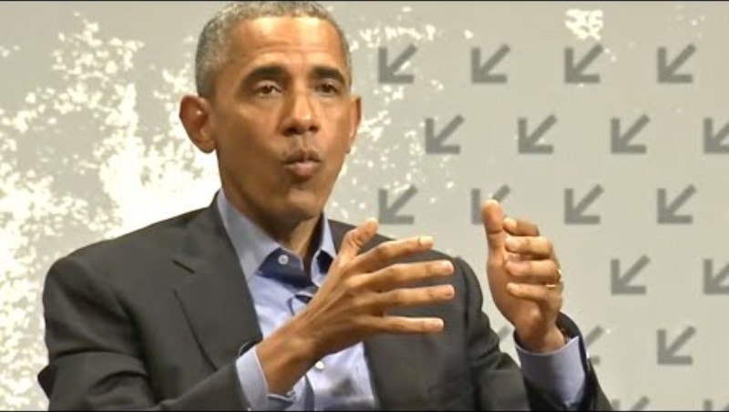
https://www.youtube.com/watch?v=ZjvX5zq7BXg

Slide 40
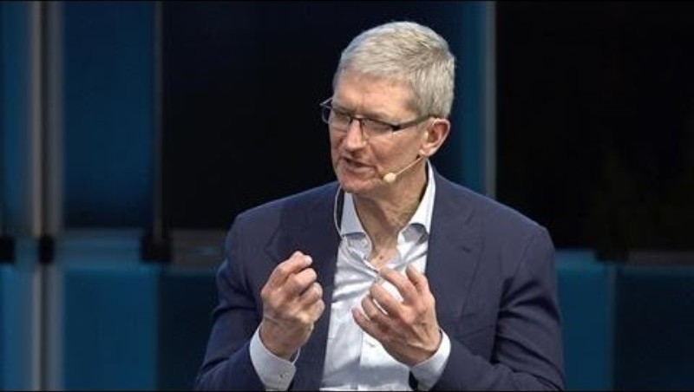
https://www.youtube.com/watch?v=BZmeZyDGkQ0

Slide 41
why was this right-vs-right?
The government had a legitimate interest in national security and fighting terrorism.
Terrorists use encryption to hide evidence.
The phone didn’t even belong to the terrorists, it belonged to the county, which also supported breaking into it.
Apple had a legitimate concern that any backdoor could be misused by the government or others and would compromise the security of customer data.
After the Snowden revelations, Apple didn’t want to be seen as aiding the government in spying.

Slide 42
were these equally important to Cook?
Commitments of Private Life
Commitments of Economic Agents
Responsibilities beyond the Firm’s Boundaries
Commitments of Company Leaders

Slide 43
were these equally important to Cook?
No. Commitments as an economic agent were clearly less important to Cook.

Slide 44
what would you have done?

Slide 45
what happened
A hearing was scheduled for March 22, 2016.
On March 21, the government obtained a delay, saying it had found a third party able to assist in unlocking the iPhone.
On March 28, the government announced that the FBI had unlocked the iPhone and withdrew its request.
Director Comey confirmed that the FBI had paid $1.3M for a zero-day exploit but would not identify the source.

Slide 46
what happened
Two years later, the Los Angeles Times reported that "the FBI eventually found that Farook's phone had information only about work and revealed nothing about the plot.“
The hackers have been speculated to be either an Israeli or an Australian firm.
https://www.youtube.com/watch?v=BZmeZyDGkQ0

